Slide 1
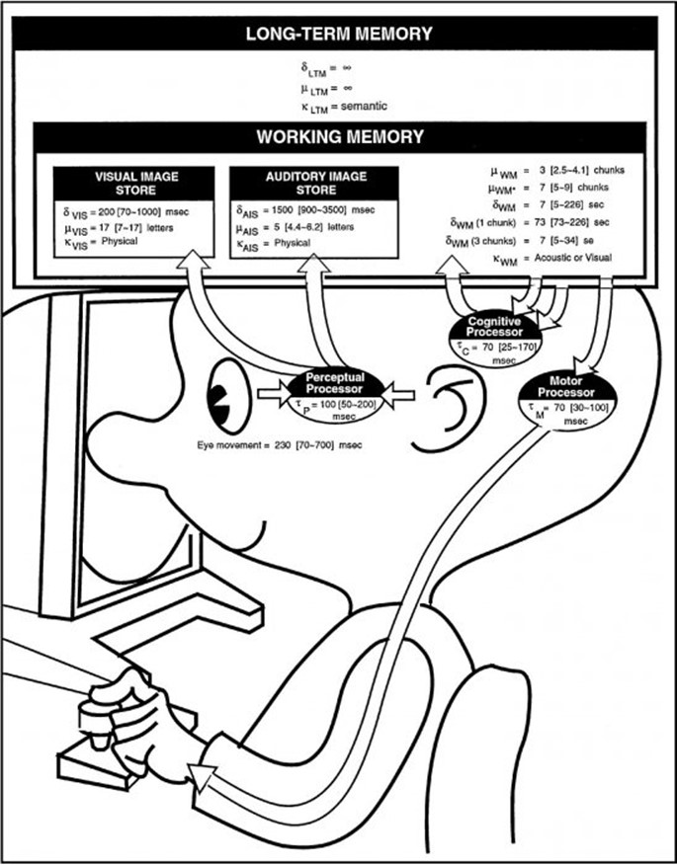
FOUNDATIONS OF UX
Thursday, 2 July 2015

Slide 2
Quick Introduction – Basic Stuff
I live in Nairobi.
I also work at iHub UX Lab.
I have been building computers since 1990.
I have been making websites since 1998.
I love scifi.
I am odd. I am not your typical mzungu.

Slide 3
Quick Introduction – Official Stuff
Samantha Merritt
Doctoral Candidate, Informatics (Human-Computer Interaction specialization)
Indiana University, Bloomington, Indiana, US
School of Informatics and Computing
PhD Minor: Cultural Anthropology
Research Committee:
Erik Stolterman (Committee Chair, Informatics, HCI, Indiana University)
Eden Medina (Social Informatics, Indiana University)
David Hakken (Social Informatics, Indiana University)
Richard Wilk (Cultural Anthropology, Indiana University)
Janet Vertesi (Sociology, Princeton University)

Slide 4
Quick Introduction – Official Stuff
Agenda and Dissertation Research Topic: Technology Design and Culture
I aim to clarify the role of culture in technology design and research. I am motivated by the challenges in “cross-cultural” technology projects and those in resource constrained contexts.

Slide 5
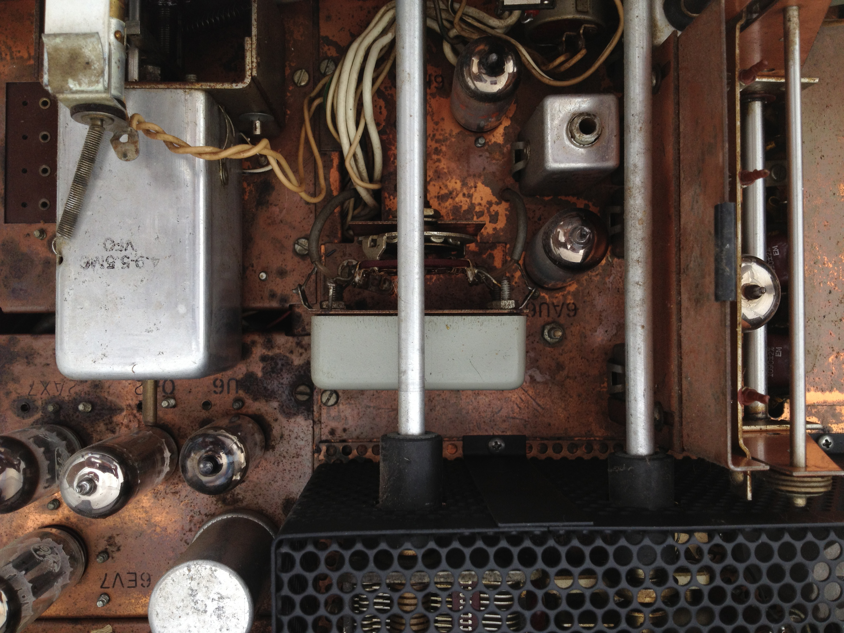
Notes:
It’s important to know the background of who’s talking to you.

Slide 6
Quick Orientation

Slide 7
FOUNDATIONS OF HUMAN COMPUTER INTERACTION
Thursday, 15January 2015

Slide 8
Today’s Plan and Objectives
Part 1: 9:00am – 10:15am
Why UX?
What is UX (and all those other words)?
What matters in UX?
History/Terminology
Break: 10:15am – 10:30am
Part 2: 10:30am – 12:30pm
Quick Usefulness
Take-Home Review Points
Homework

Slide 9
Why UX?
You tell me.

Slide 10
Terminology Deluge
So many words….

Slide 11
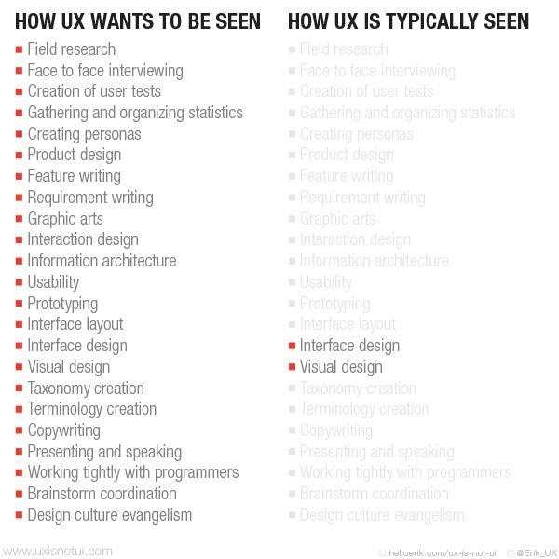

Slide 12
Try this…
Write down every word you know related to the field of human-computer interaction (or UX) and the kinds of work/specialties, tasks, or disciplines.
Now, try to organize them as you think is best.
Make a …
picture.
diagram.
flowchart.
hierarchy.
Venn diagram (or set diagram).
Does anything overlap? How much?
Are there words with the same meaning?
Do some elements oppose each other?
Which words do you know, but feel you do not understand at all?

Slide 13
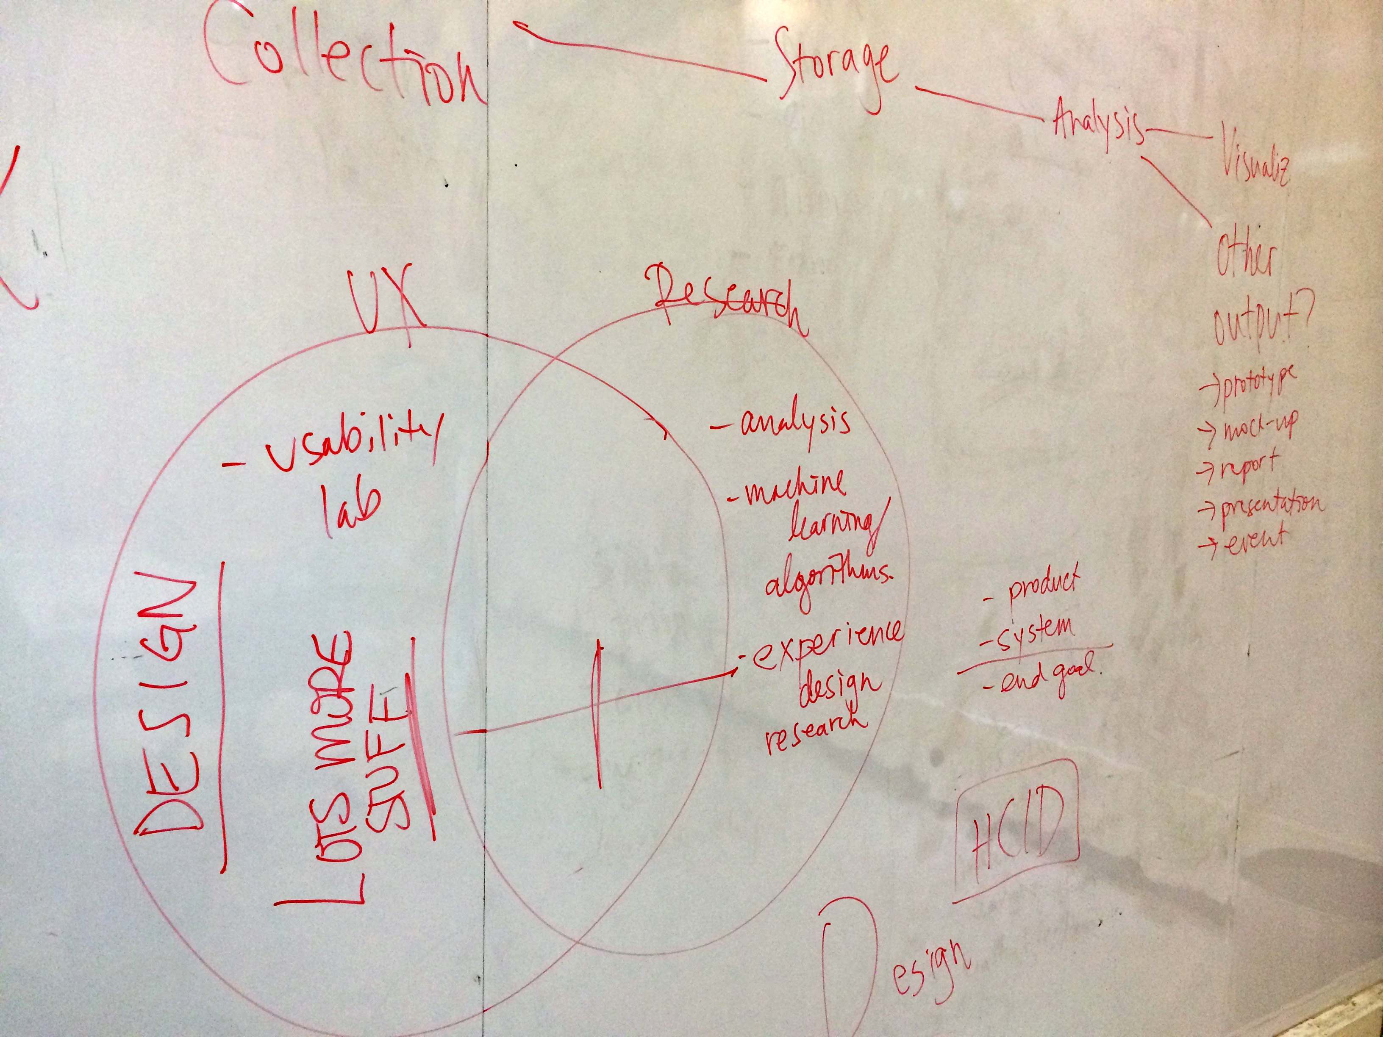

Slide 14
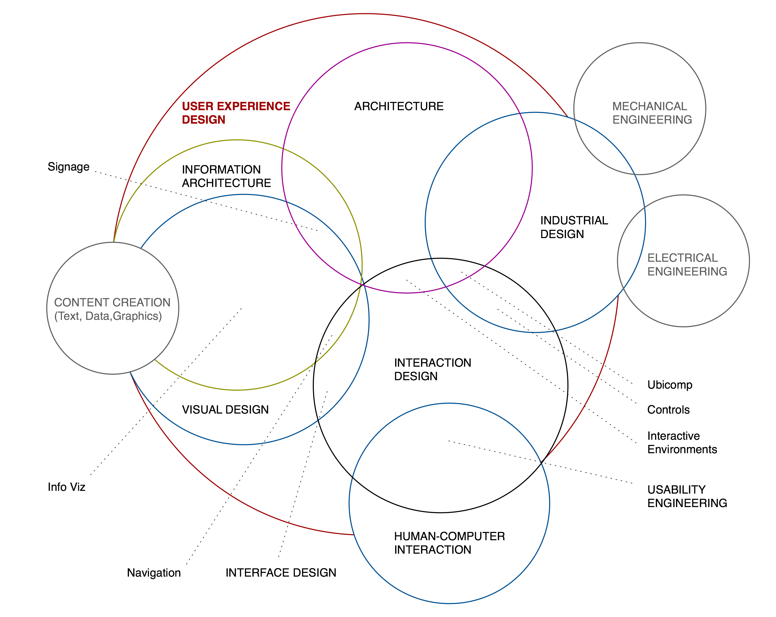
http://www.kickerstudio.com/2008/12/the-disciplines-of-user-experience/

Slide 15
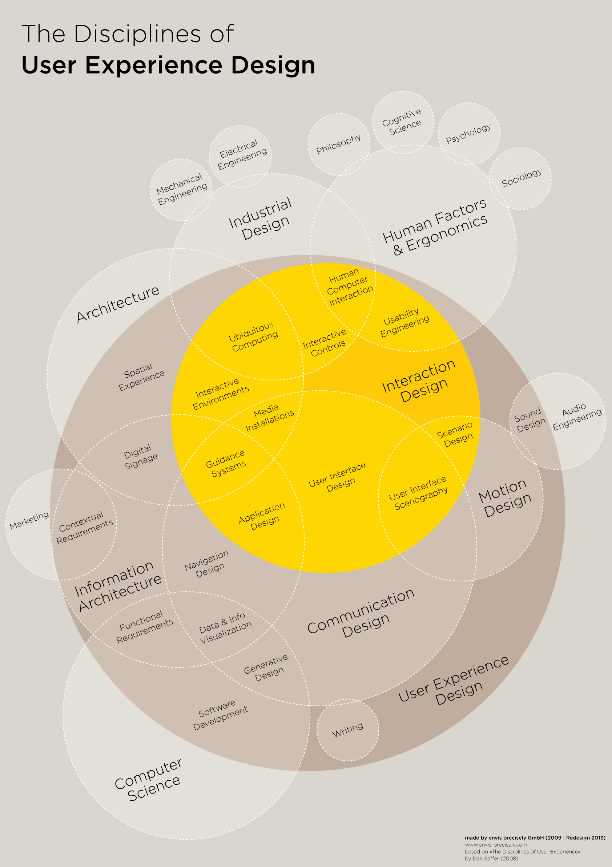
http://visual.ly/disciplines-user-experience-design

Slide 16
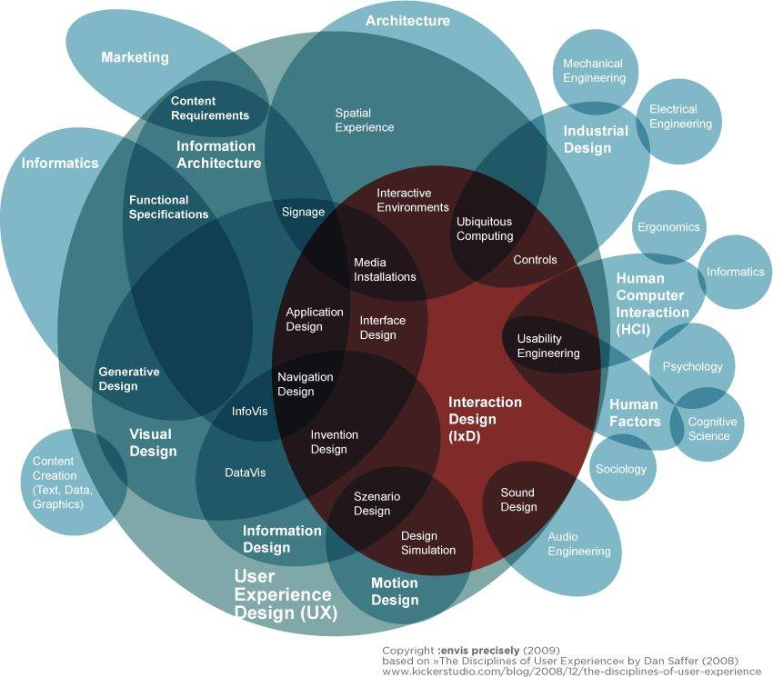

Slide 17
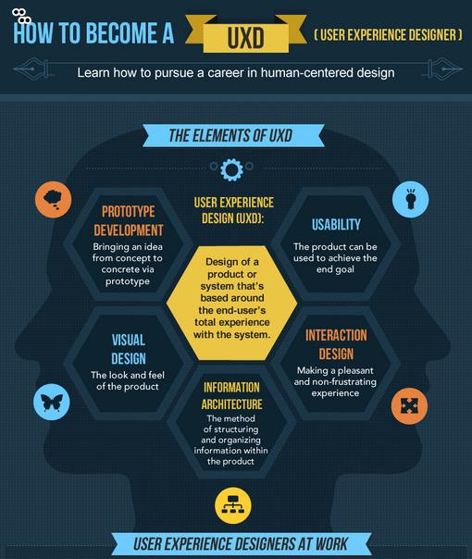
http://www.theworkbuzz.com/find-the-job/infographic-how-to-become-a-ux-designer/

Slide 18
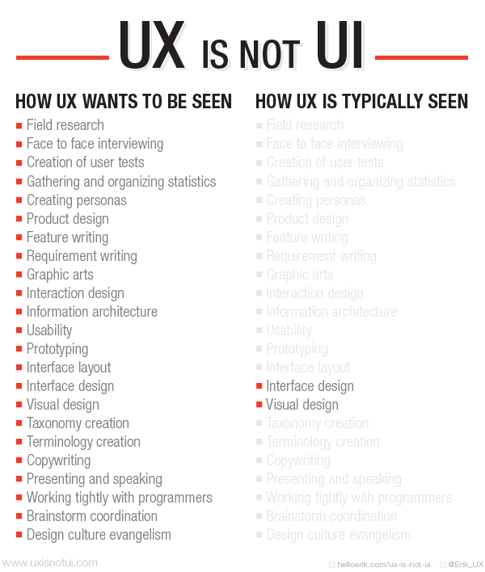
uxisnotui.com

Slide 19
Confused? You’re not alone.
“…Don’t see this as the only road map for the entire UX design industry, but a postulation as to why it’s so darned complicated to nail good UX. To think anyone could be an expert in each of these circles is sheer absurdity. Scratch that: To think any designer could be an expert in each of these circles is sheer absurdity, but to recognize that every end user is an expert in each of these circles is highly important. As humans and end users, we might not know what makes an experience right, but we certainly know when it’s wrong.”
http://www.fastcodesign.com/1671735/infographic-the-intricate-anatomy-of-ux-design

Slide 20
Confused? You’re not alone.
“…Don’t see this as the only road map for the entire UX design industry, but a postulation as to why it’s so darned complicated to nail good UX. To think anyone could be an expert in each of these circles is sheer absurdity. Scratch that: To think any designer could be an expert in each of these circles is sheer absurdity, but to recognize that every end user is an expert in each of these circles is highly important. As humans and end users, we might not know what makes an experience right, but we certainly know when it’s wrong.”
http://www.fastcodesign.com/1671735/infographic-the-intricate-anatomy-of-ux-design

Slide 21
Confused? You’re not alone.
“…Don’t see this as the only road map for the entire UX design industry, but a postulation as to why it’s so darned complicated to nail good UX. To think anyone could be an expert in each of these circles is sheer absurdity. Scratch that: To think any designer could be an expert in each of these circles is sheer absurdity, but to recognize that every end user is an expert in each of these circles is highly important. As humans and end users, we might not know what makes an experience right, but we certainly know when it’s wrong.”
http://www.fastcodesign.com/1671735/infographic-the-intricate-anatomy-of-ux-design

Slide 22
Notes:
THIS IS A PROBLEM.
It becomes a challenge to know when and where a distinction exists and where it is artificial/invented or a product of confusion.

Slide 23
uxisnotui.com

Slide 24
uxisnotui.com

Slide 25
uxisnotui.com

Slide 26
uxisnotui.com

Slide 27
uxisnotui.com

Slide 28
Terminology and Abbreviations:
HCI:
Human-computer interaction
ICT:
Information communication technologies
ICT4D:
Information communication technologies for (socioeconomic) development

Slide 29
… So what really matters?
The user.

Slide 30

Why bother with history?

Slide 31
Before HCI
Part 1: History in Three Waves
Notes:
Quick fun-fact, not too serious here: paper from 1960 (psychologist and computer scientist, died in 1990, philosophical genesis of the network and ideas leading to the internet, augmented intelligence of humans through interacting with computers)
Licklider envisioned some of the paradigms of interaction to come in following decades and talked a lot about engineering requirements and the concept/philosophy of what it means for a human to work mechanically extended by a computer.

Slide 32
Paradigms of Technology Design
“…a paradigm refers to a particular approach that has been adopted by the community of researchers and designers for carrying out their work, in terms of shared assumptions, concepts, values, and practices …a set of practices that a community has agreed upon…”
Preece, J., Rogers, Y. and Sharp, H. Interaction Design: Beyond Human-Computer Interaction. 2nd ed.
West Sussex, England: John Wiley & Sons Ltd, 2007. p. 218.

Slide 33
Paradigms of Technology Design
“…a paradigm refers to a particular approach that has been adopted by the community of researchers and designers for carrying out their work, in terms of shared assumptions, concepts, values, and practices …a set of practices that a community has agreed upon, including:
The questions to be asked and how they should be framed.
The phenomena to be observed.
The way findings from experiments are to be analyzed and interpreted (Kuhn, 1962).”
Preece, J., Rogers, Y. and Sharp, H. Interaction Design: Beyond Human-Computer Interaction. 2nd ed.
West Sussex, England: John Wiley & Sons Ltd, 2007. p. 218.

Slide 34
Paradigms of Technology Design
Preece, J., Rogers, Y. and Sharp, H. Interaction Design: Beyond Human-Computer Interaction. 2nd ed.
West Sussex, England: John Wiley & Sons Ltd, 2007. p. 220.
Notes:
Windows (that could be scrolled, stretched, overlapped, opened, closed, and moved around the screen using the mouse).
Icons (that represented applications, objects, commands, and tools that were opened or activated when clicked on).
Menus (offering lists of options that could be scrolled through and selected in the way a menu is used in a restaurant).
pointing device (a mouse controlling the cursor as a point of entry to the windows, menus, and icons on the screen).

Slide 35
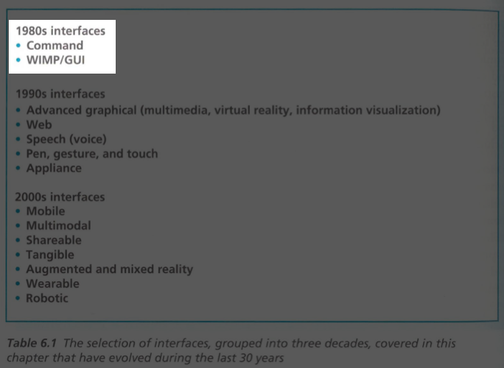
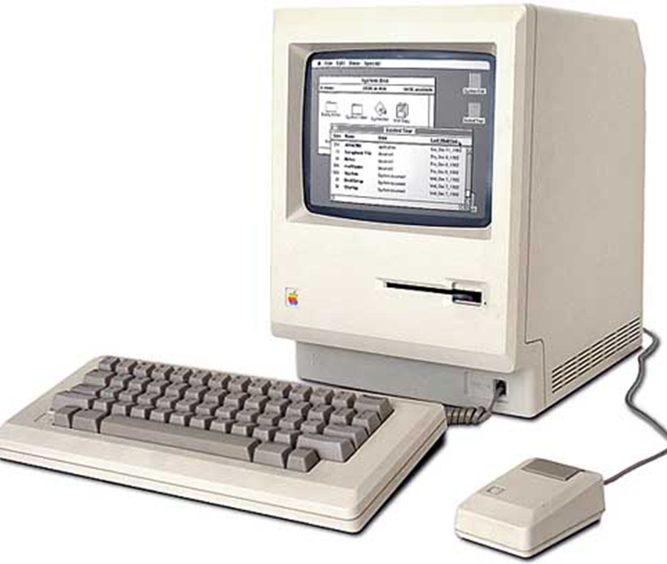
Paradigms of Technology Design
Preece, J., Rogers, Y. and Sharp, H. Interaction Design: Beyond Human-Computer Interaction. 2nd ed.
West Sussex, England: John Wiley & Sons Ltd, 2007. p. 220.
Notes:
Windows (that could be scrolled, stretched, overlapped, opened, closed, and moved around the screen using the mouse).
Icons (that represented applications, objects, commands, and tools that were opened or activated when clicked on).
Menus (offering lists of options that could be scrolled through and selected in the way a menu is used in a restaurant).
pointing device (a mouse controlling the cursor as a point of entry to the windows, menus, and icons on the screen).

Slide 36
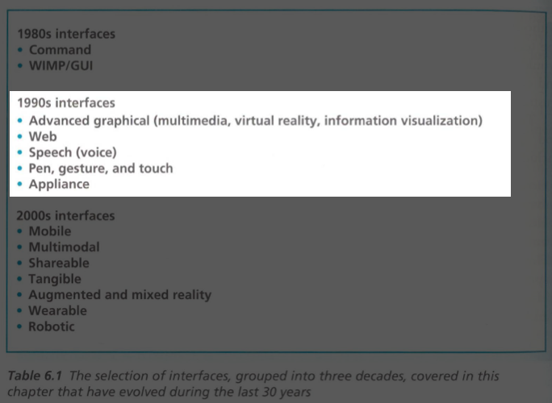
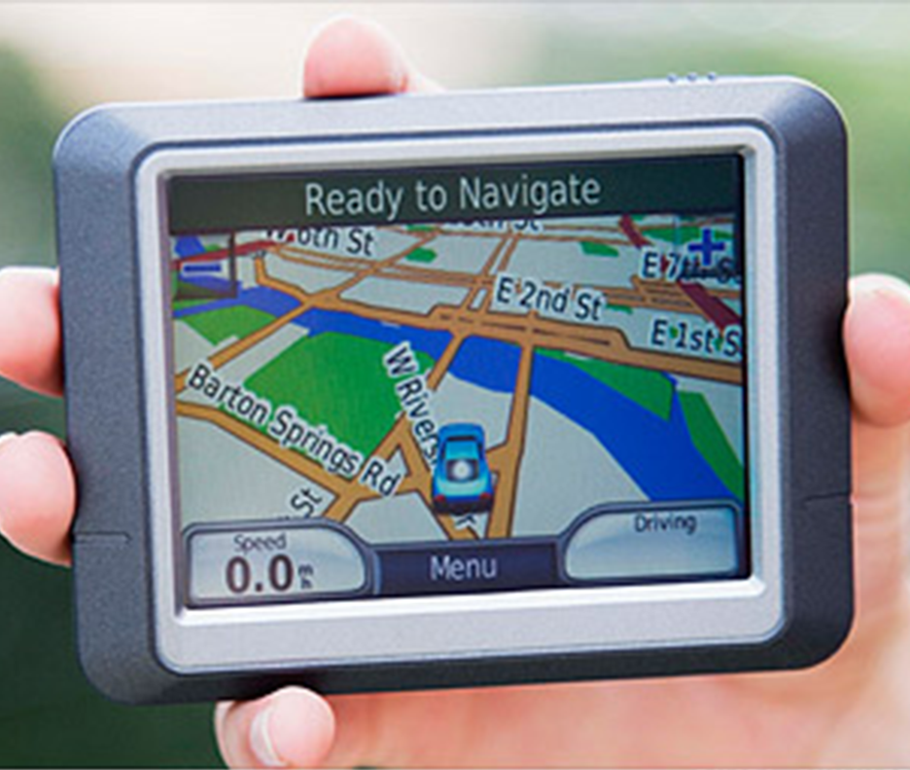
Paradigms of Technology Design
Preece, J., Rogers, Y. and Sharp, H. Interaction Design: Beyond Human-Computer Interaction. 2nd ed.
West Sussex, England: John Wiley & Sons Ltd, 2007. p. 220.
Notes:
Windows (that could be scrolled, stretched, overlapped, opened, closed, and moved around the screen using the mouse).
Icons (that represented applications, objects, commands, and tools that were opened or activated when clicked on).
Menus (offering lists of options that could be scrolled through and selected in the way a menu is used in a restaurant).
pointing device (a mouse controlling the cursor as a point of entry to the windows, menus, and icons on the screen).

Slide 37
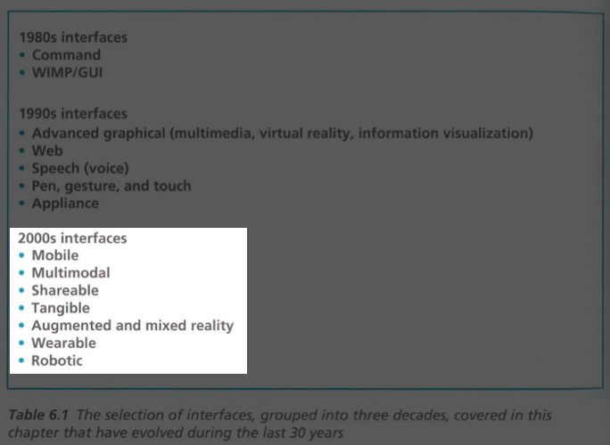

Paradigms of Technology Design
Preece, J., Rogers, Y. and Sharp, H. Interaction Design: Beyond Human-Computer Interaction. 2nd ed.
West Sussex, England: John Wiley & Sons Ltd, 2007. p. 220.
Notes:
Windows (that could be scrolled, stretched, overlapped, opened, closed, and moved around the screen using the mouse).
Icons (that represented applications, objects, commands, and tools that were opened or activated when clicked on).
Menus (offering lists of options that could be scrolled through and selected in the way a menu is used in a restaurant).
pointing device (a mouse controlling the cursor as a point of entry to the windows, menus, and icons on the screen).

Slide 38
Paradigms of Technology Design
Preece, J., Rogers, Y. and Sharp, H. Interaction Design: Beyond Human-Computer Interaction. 2nd ed.
West Sussex, England: John Wiley & Sons Ltd, 2007. p. 220.
Notes:
Windows (that could be scrolled, stretched, overlapped, opened, closed, and moved around the screen using the mouse).
Icons (that represented applications, objects, commands, and tools that were opened or activated when clicked on).
Menus (offering lists of options that could be scrolled through and selected in the way a menu is used in a restaurant).
pointing device (a mouse controlling the cursor as a point of entry to the windows, menus, and icons on the screen).

Slide 39
First Wave
Characterizing Features:
Lab-based
Humans as computers or information processors
Task analysis and predictive models
Error-reduction and efficiency focused
Descriptive models of human behavior
Notes:
Cartoon from Card, Moran, and Newell 1983 (The Psychology of Human Computer Interaction)

Slide 40
Notes:
It got pretty bad, there were models of models and maps of the models! ☺
Don’t worry, I’m not going to go through this!! ☺ What is important to understand about this period in time was the focus on …

Slide 41
Notes:
1985

Slide 42
Three Principles They Recommend:
1. Early Focus on Users and Actual Tasks
2. Empirical Measurement of Actual Users
3. Iterative Design Responding to Results
“We recommend understanding potential users, versus “identifying,” “describing,” “stereotyping,” and “ascertaining” them, as respondents suggested.”
“We recommend bringing the design team into direct contact with potential users, as opposed to hearing or reading about them through human intermediaries, or through an “examination of user profiles.”
“These interviews should be conducted prior to system design, instead of first designing the system and then subsequently “presenting,” “reviewing,” and “verifying” the design with users, or “getting users to agree” to, or to “sign off” on the design.”
Problematic Beliefs:
Belief ...
In the Power of Reason (alone)
Good Design Guidelines Should be Sufficient
Good Design Means Getting It Right the First Time
the Development Process Will Be Lengthened
Iteration Is Just Expensive Fine-Tuning
In The Power of Technology to Succeed (alone)
Notes:
1985

Slide 43
Second Wave
Characterizing Features:
“From Human Factors to Human Actors”
Studies in workplaces (actual world, not in a lab)
Interest in groups over only individuals
Move toward design, user involvement, and iteration
Qualitative research methods (ethnography)
Participatory design* methods also move in
Other terms: Situated Action, Distributed Cognition, Activity Theory
*I will be presenting on this topic soon. ☺
Notes:
Aside: Bannon, L. (1986). From human factors to human actors: the role of psychology and human-computer interaction studies in system design, Greenbaum, J. & Kyng, M. (eds). Design at work: cooperative design of computer systems table of contents, Erlbaum, pp. 25-44.
Aside: Four Concepts from Olson paper: 1. Common Ground, 2. Tight/Loose coupling of work, 3. Collaboration readiness, 4. Technology readiness

Slide 45
Third Wave
Characterizing Features:
Concern moved from workplace to home, daily life, society, etc.
Culture, art, emotion, empathy, experience, and critical became keywords
Input from broad range of fields and disciplines (art, critical literature, feminist studies, etc.)
Presently this is the new paradigm being worked out in some communities.
Notes:
Sometimes referred to as critical turn or the "Phenomenological matrix."

Slide 46
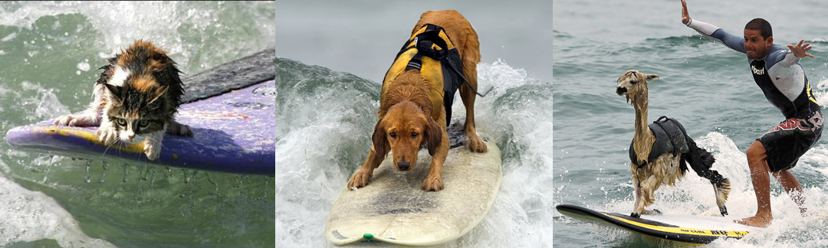
It’s a wavy ocean…
Notes:
“I claim that traditional human factors work, although it undoubtedly has merit, and has produced many improvements to existing technological systems, is often too limited in scope with respect to its view of the person.” –Bannon on Wave 1 to Wave 2

Slide 47
It’s a wavy ocean… but that’s okay.
Today, in the work of HCI, interaction design, user experience design (UX), or related fields, the work of all these “waves” still takes place or is in use in one form or another—for both design and research.
Notes:
It’s helpful however, to know what sort of work you are doing, and how it fits into the larger picture.
“I claim that traditional human factors work, although it undoubtedly has merit, and has produced many improvements to existing technological systems, is often too limited in scope with respect to its view of the person.” –Bannon on Wave 1 to Wave 2

Slide 48
Exam!

Slide 52
Specialized Areas or Related Fields
Ubiquitous Computing (UbiComp)
Computer Supported Cooperative Work (CSCW)
Human Factors and Ergonomics
User Centered Design
ICT4D and HCI4D
Technology Design
Interaction Design and Experience Design
UX and UXd
Design Theory
…
Notes:
For each of those “waves” at least one (often many) specializations or related sub fields appeared. They are all (in varying degrees) relevant for all of us! Whether you consider yourself UX or research, or a coder.

Slide 53
Specialized Areas or Related Fields
Ubiquitous Computing (UbiComp)
Computer Supported Cooperative Work (CSCW)
Human Factors and Ergonomics
User Centered Design
ICT4D and HCI4D
Technology Design
Interaction Design and Experience Design
UX and UXd
Design Theory
…
Part 1: Specialized Discourses
Notes:
Focus on this one.

Slide 54
ICT4D
Notes:
The problem of the “4”

Slide 55
ICT4D or ICTD
Notes:
The problem of the “4”

Slide 56
HCI4D
Notes:
Then HCI gets a hold of the idea.

Slide 57
HCI4D
Notes:
Then HCI gets a hold of the idea.

Slide 58
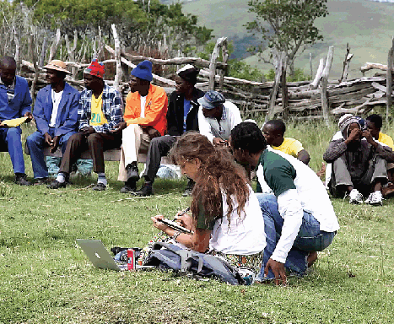
None of the Above…
Notes:
Then there are people who simply refuse the label, because it’s not about the “4” or the “D.”

Slide 59
http://www.theguardian.com/media/video/2011/jun/22/google-africa-technology-video?intcmp=239
Notes:
PLAY VIDEO HERE!
Video: http://www.guardian.co.uk/media/video/2011/jun/22/google-africa-technology-video?intcmp=239
Play: 1:00 - 3:50
This is a clip from a conference called Activate Summit (2011, London)

Slide 60
Problem Approach is Important
“More often than not, especially when it comes to Africa and the developing world, there is this idea that the only lens with which we look at technology is ICT4D ... It drives me nuts. It limits the potential of technology ... and it makes a fundamental wrong assumption: that we don't enjoy technology like everyone else does.”
Ory Okolloh
Manager, Government and Policy Relations, Africa - Google
Notes:
PLAY VIDEO HERE!
Video: http://www.guardian.co.uk/media/video/2011/jun/22/google-africa-technology-video?intcmp=239
Play: 1:00 - 3:50
This is a clip from a conference called Activate Summit (2011, London)

Slide 61
ICTs in* Developing Nations
*not “for” development, but simply there. :)
Technology design, invention, and creation happens anywhere and for varied reasons.
ICTs, like Okolloh suggests, are sometimes for enjoyment and communication—not solely economic development purposes.
This is obvious to some, not to others!
Notes:
This slide is stressing the “IN” versus “FOR”

Slide 62
Sam’s UX ProTips
Notes:
PLAY VIDEO HERE!
Video: http://www.guardian.co.uk/media/video/2011/jun/22/google-africa-technology-video?intcmp=239
Play: 1:00 - 3:50
This is a clip from a conference called Activate Summit (2011, London)

Slide 63
Constraints are awesome. Critique is not opinion. All UX is knowledge based. For every rule, there is a reason to break it. You are not, and never will be, your user. Users are bad designers, but they know bad design. Expect to be wrong, and embrace it. It depends. Be reflexive. Ideas are easy, good UX is hard.

Slide 64
Quick Usefulness
Man on the street –ish.

Slide 65
Take Homes, What are they?
Why UX?
What is UX (and all those other words)?
What matters in UX?
History/Terminology

Slide 66
Homework
DUE: Tuesday night via email
Readings
Don Norman, The Design of Everyday Things
User Centered Design
Salvador, Design Ethongraphy
Usefulness for you – Man on the Street Interview
Email Samantha answers from 3 users and the questions you asked.

Slide 67
Image Sources*
Macintosh Computer:
http://oldcomputers.net/pics/macintosh.jpg
GPS:
http://i2.cdn.turner.com/money/galleries/2011/technology/1110/gallery.government_inventions/images/gps-navigation.ju.jpg
Google Glass:
http://www.androidheadlines.com/wp-content/uploads/2013/04/google-glass-wallpaper-hd.jpg
Surfing Cat:
http://4.bp.blogspot.com/-6nEL_gkYi9c/T1QwywMuH9I/AAAAAAAAAag/N7vuIqS-h8A/s1600/surfing%2Bcat.jpg
Surfing Dog:
http://www3.allaroundphilly.com/blogs/trentonian/weird/uploaded_images/Surfer-Dude-Dog-703356.jpg
Surfing Llama:
http://static.fjcdn.com/large/pictures/57/8c/578c81_418704.jpg
Nicola Bidwell:
http://deliveryimages.acm.org/10.1145/2380000/2377797/ins01.gif
*Image credits for diagrams are on each slide. Contact me for additional source references.

Slide 68
Ask me questions!
Thank you.
All of the papers mentioned today will be made available to you after today’s training.
Samantha Merritt
iHub UX Lab, Operations Lead
Indiana University, School of Informatics and Computing
Social Media and Stuff:
Twitter: @zuanto
Email: sam@moringaschool.com
http://samanthamerritt.com/blog/

